Slide 1
Large Graphs Embedding
--Yiran Shan
--2018.04.03

Slide 2
Literature Review
Paper:
LINE: Large-scale Information Network Embedding
Inductive Representation Learning on Large Graphs
CNN/GCN
RNN/LSTM
DeepWalk & word2vec
Node2vec
------------------------------------------------------------------------------------------
VGG / GAP
ResNet
DenseNet
Capsule

Slide 3



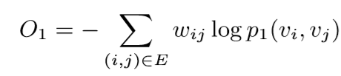
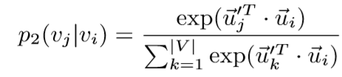




LINE: Large-scale Information Network Embedding
First-order
$O_{1}=D_{KL}\left(p_{1}\left(·,·\right),{\hat{p}}_{1}(·,·)\right)$
Second-order
${ O}_{1}=D_{KL}\left(p_{1}\left(·,·\right),{\hat{p}}_{1}(·,·)\right)$

Slide 4
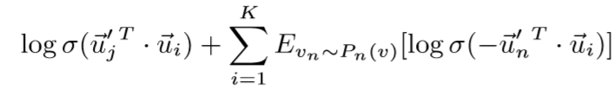

LINE: Large-scale Information Network Embedding
Model Optimization—Negative Sampling
（ASGD）Asynchronous stochastic gradient algorithm

Slide 5
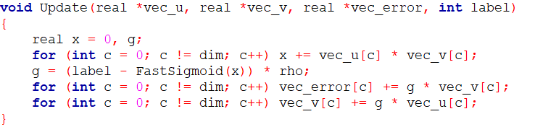
LINE: Large-scale Information Network Embedding
Gradient Descent

Slide 6
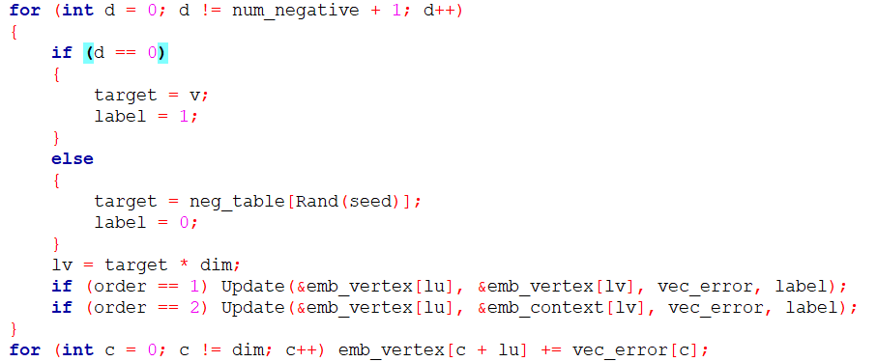
LINE: Large-scale Information Network Embedding
Negative Sample:

Slide 7
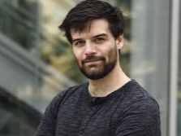
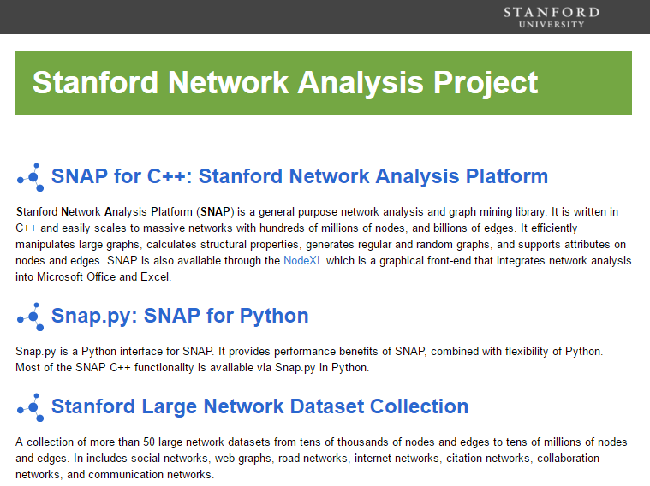
Inductive Representation Learning on Large Graphs
Tutorials on using SNAP, on methods to analyze large network data, on ways how to think about networks and how to model them at the level of network structure, and on methods to study evolution and dynamics of diffusion and cascading behavior in networks.

Slide 8
Inductive Representation Learning on Large Graphs
Motivation
inherently transductive and can only generate embeddings for a single fixed graph
These transductive approaches do not efficiently generalize to unseen nodes
these approaches cannot learn to generalize across different graphs.
GraphSAGE is an inductive framework that leverages node attribute information.

Slide 9
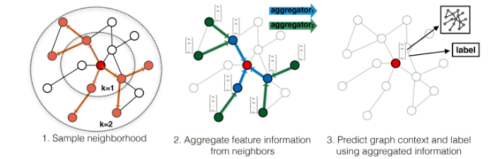
Inductive Representation Learning on Large Graphs

Slide 10

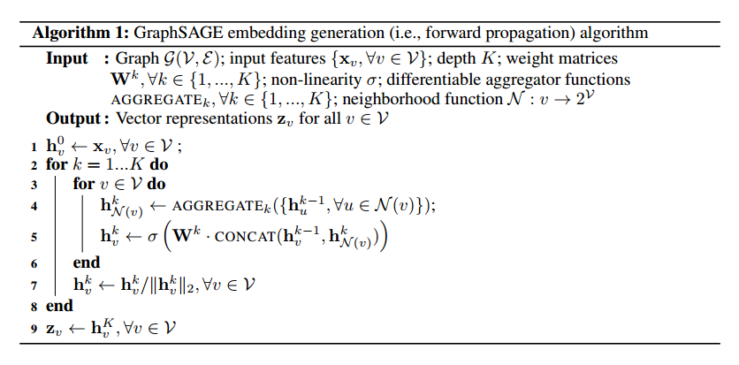
Inductive Representation Learning on Large Graphs

Slide 11
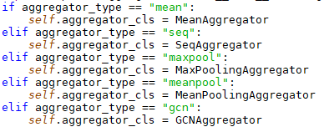
Inductive Representation Learning on Large Graphs
Learning W
Mean
LSTM
pool

Slide 12

Inductive Representation Learning on Large Graphs
GCNAggregator:
Question : GCN ?
Next ppt (CNN->GCN)

Slide 13

Inductive Representation Learning on Large Graphs
MeanAggregator:

Slide 14


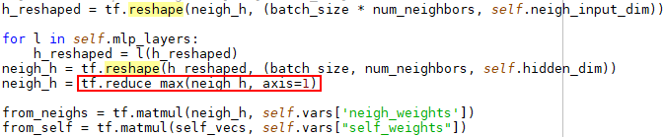
Inductive Representation Learning on Large Graphs
MaxPoolingAggregator/MeanPoolingAggregator:
multi-layer perceptron Realization

Slide 15
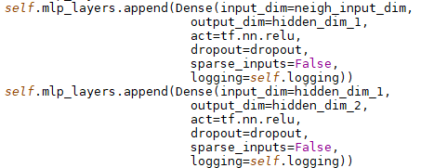
Inductive Representation Learning on Large Graphs
TwoMaxLayerPoolingAggregator:

Slide 16

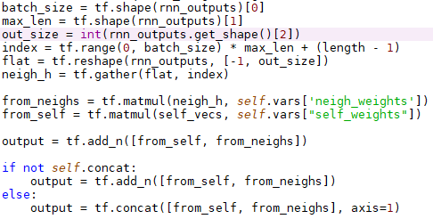
Inductive Representation Learning on Large Graphs
SeqAggregator: (Aggregates via a standard LSTM.)

Slide 17
GCN
Motivation
generalization of neural network models to such structured datasets.
CNN cannot handle the non Euclidean Structure
Related work
Vertex domain(Learning Convolutional Neural Networks for Graphs(2016))
Spectral domain(Spectral Networks and Deep Locally Connected Networks on Graph(2014))
Convolutional Neural Networks on Graphs With Fast Localized Spectral Filtering(2016)
Semi-Supervised Classification with Graph Convolution Network(2016)

Slide 18
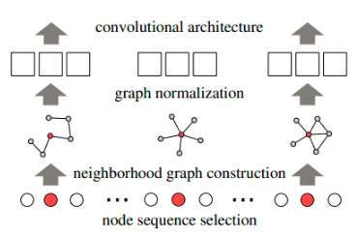
Learning Convolutional Neural Networks for Graphs(2016ICML)
Node Sequence Selection
Neighborhood Assembly
Graph Normalization
Convolutional Architecture

Slide 19
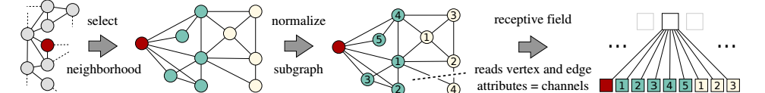
Learning Convolutional Neural Networks for Graphs(2016ICML)
Node Sequence Selection
graph labeling（color refinement or vertex classification）
The Weisfeiler-Lehman algorithm(return every node’s rank)
Take first w nodes.(padding)
Neighborhood Assembly
Bfs(take k’s neighborhood)
Graph Normalization
Convolutional Architecture
Notes:
graph labeling（对图的节点做标记，比如可以用节点的度做标记，做图的划分，也 可以叫做color refinement or vertex classification）

Slide 20

Spectral domain(Spectral Networks and Deep Locally Connected Networks on Graph(2014))
Motivation:
Use a blackboard………………….
Spectral graph convolution
Two shortcoming
Θ has as large scale as the number of the node
Time complexity: O(n^2)

Slide 21
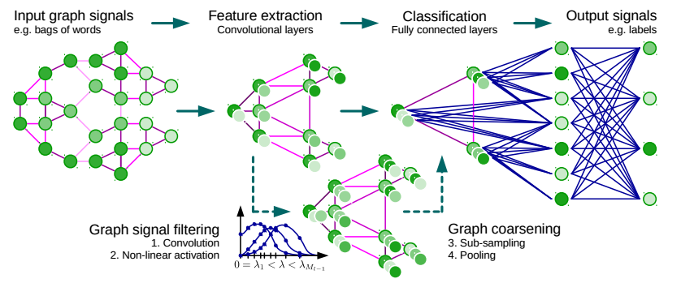
Convolutional Neural Networks on Graphs With Fast Localized Spectral Filtering(2016)

Slide 22


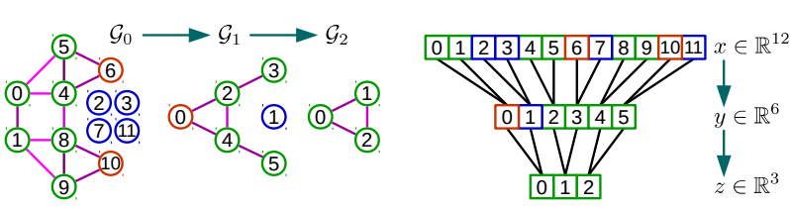
Convolutional Neural Networks on Graphs With Fast Localized Spectral Filtering(2016)
Convolutional:
Pooling

Slide 23

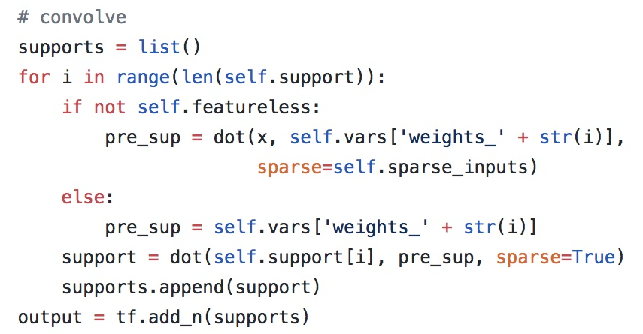
Semi-Supervised Classification with Graph Convolution Network(2016) <k = 1>

Slide 24
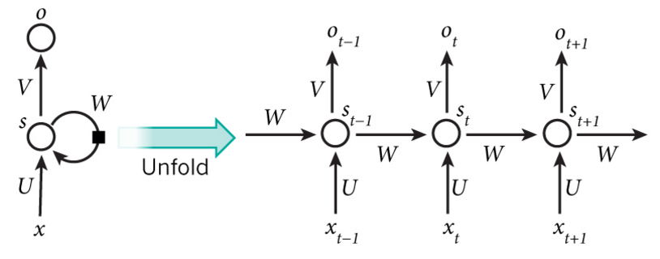
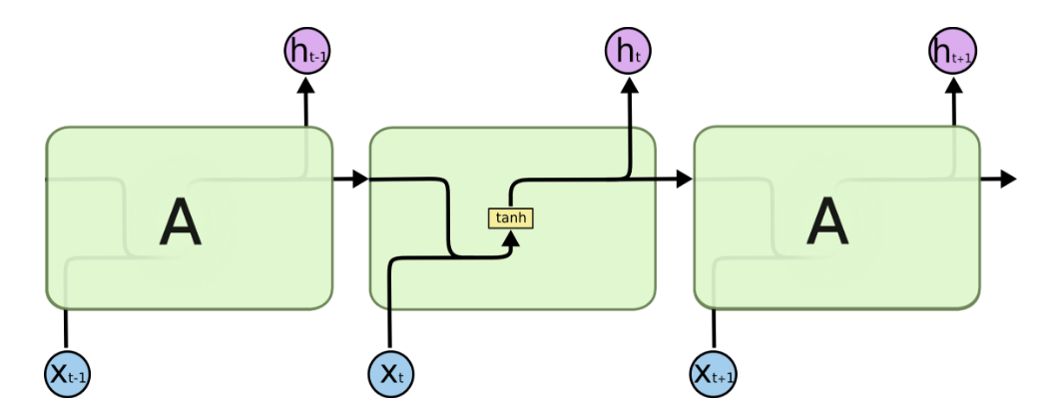

RNN(Recurrent Neural Networks)
Sequence mining

Slide 25
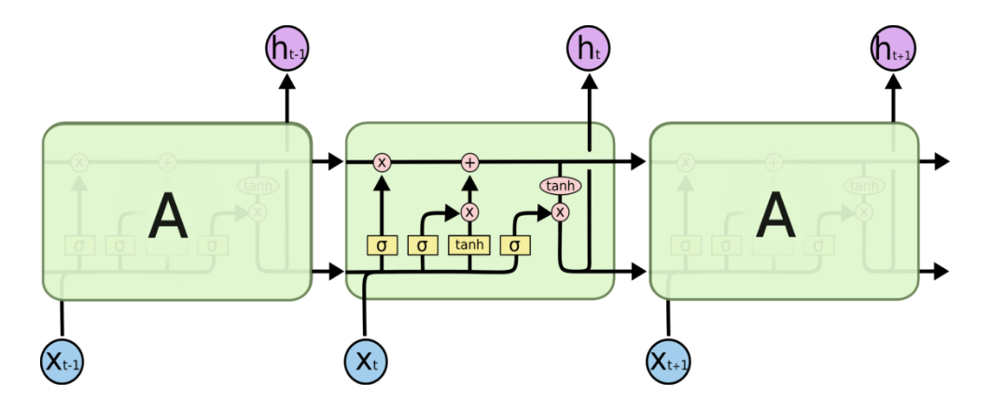
LSTM（Long Short Term Memory）
Motivation:
RNN is hard to deal with long-term dependence.(vanishing gradient problem and exploding gradient problem)

Slide 26
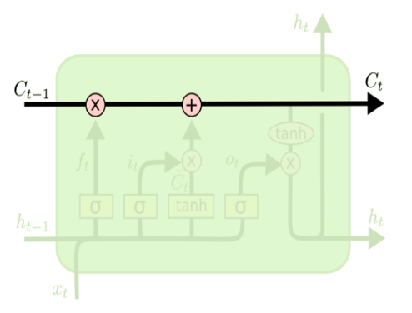
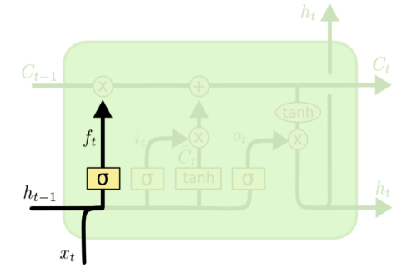
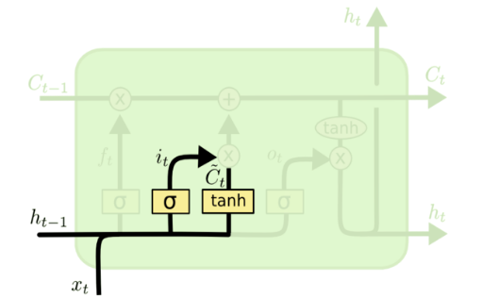
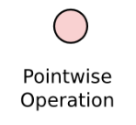

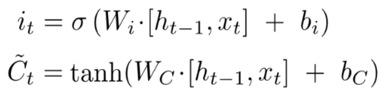
LSTM（Long Short Term Memory）

Slide 27
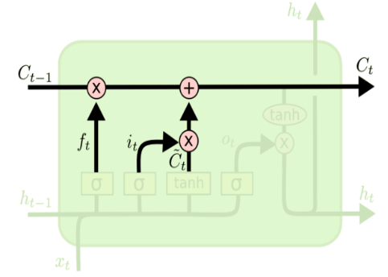
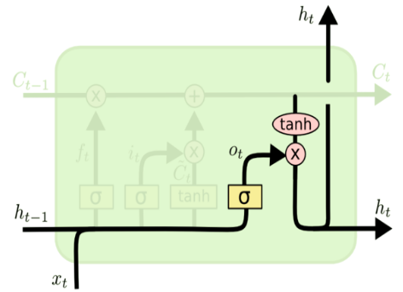

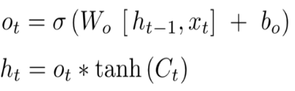
LSTM（Long Short Term Memory）

Slide 28
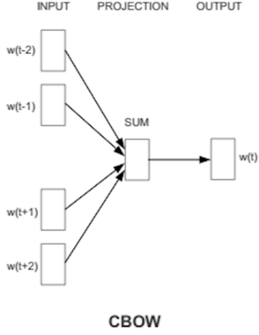
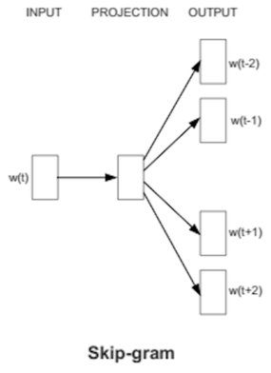
word2vec

Slide 29
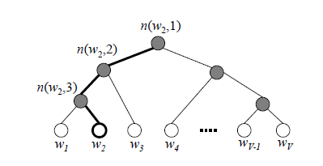




word2vec
Hierarchical Softmax
Negative Sampling

Slide 30
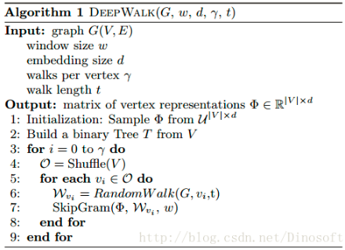
DeepWalk
Rrandom Walk + Skip-gram

Slide 31
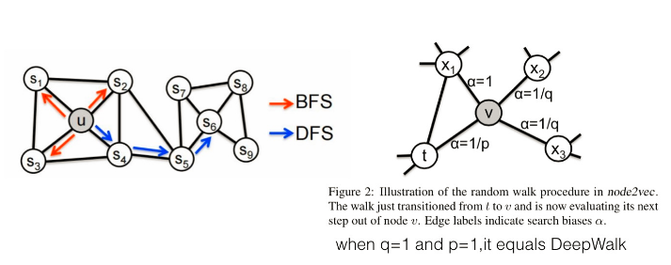
node2vec
bias random walk
+Skip-gram

Slide 32
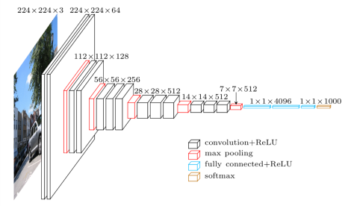
VGG / GAP
VGG(ImageNet 2014)
GAP(Global Average Pooling)

Slide 33
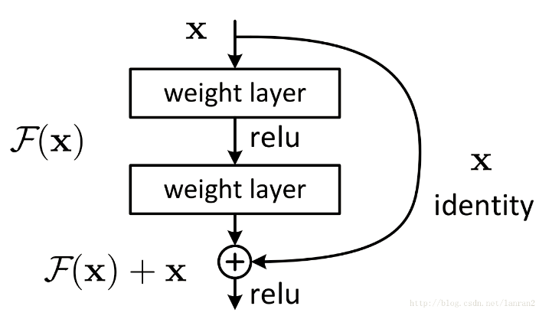
ResNet(ImageNet2015)
F(x)→ y-x
x + F(x)→ y
Handle exploding gradient problem

Slide 34
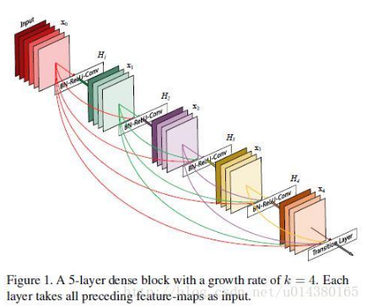
DenseNet(CVPR2017)
Each layer takes all preceding feature-maps as input
Handle vanishing-gradient

Slide 35
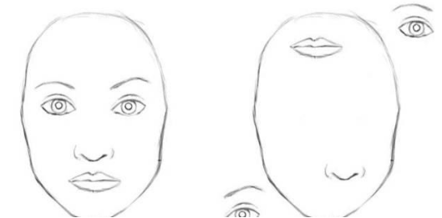
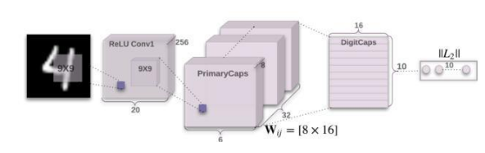
Capsule(Hinton)

Slide 36
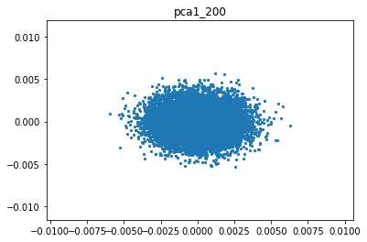
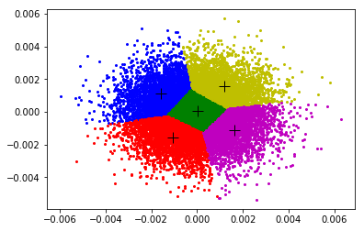
LINE: Large-scale Information Network Embedding
1_200_PCA
1_200_PCA_KMEANS

Slide 37
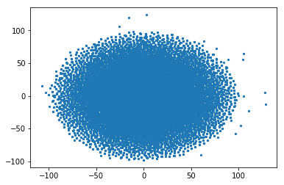
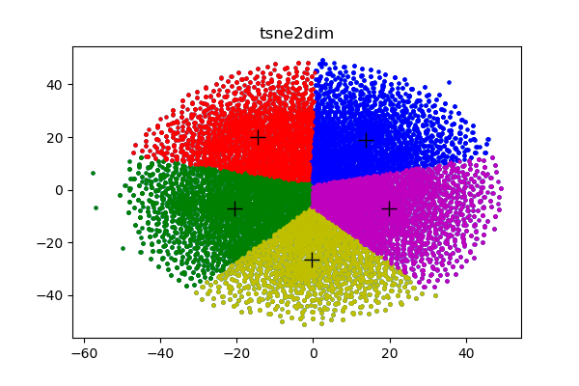
LINE: Large-scale Information Network Embedding
1_100_tSNE_Perplexity = 30
1_100_tSNE_KMEANS

Slide 38
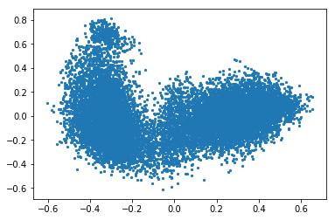
GraphSAGE result
ppi Network
Environment：
TensorFlow
GPU
(docker)
networkx

Slide 39
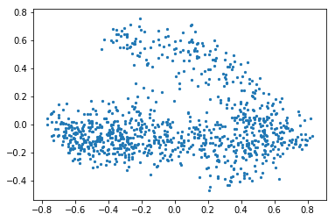
GraphSAGE
Our Network result (one batch)

Slide 40
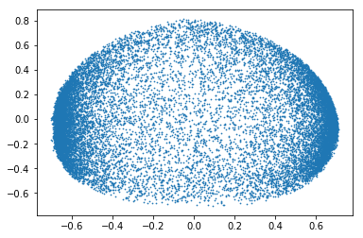
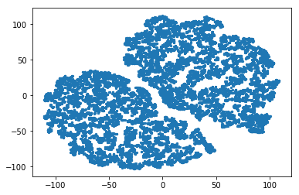
GraphSAGE
PCA tSNE

Slide 41
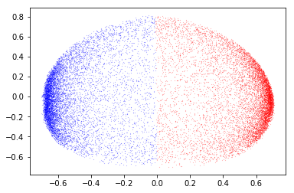
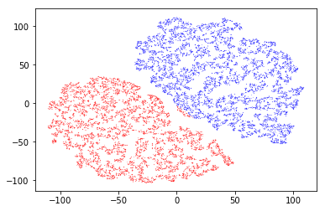
GraphSAGE
PCA tSNE

